Slide 1
Section 1.5: Algorithms for Solving Graph Problems
Math for Liberal Studies

Slide 2
Brute Force is Hard!
As we have seen, the brute force method can require us to examine a very large number of circuits
In this section we will develop algorithms for finding an answer much more quickly
The downside is that we will no longer be guaranteed to have the best possible answer

Slide 3
Nearest-Neighbor Algorithm
The first algorithm we will consider is called the nearest-neighbor algorithm
It’s based on a common sense idea: at each vertex, choose the closest vertex that you haven’t visited yet

Slide 4
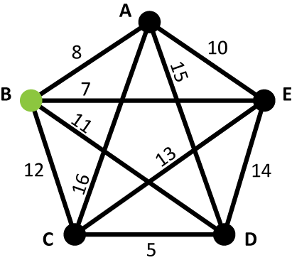
Nearest-Neighbor Algorithm
We have to have a starting point
We will choose our second vertex by finding the “nearest neighbor”

Slide 5
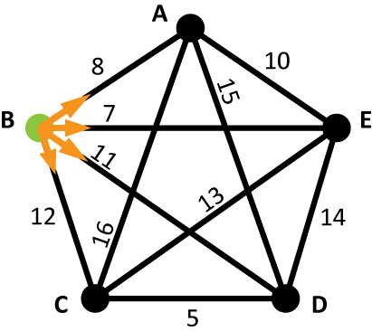
Nearest-Neighbor Algorithm
Where do we go first?
Choose the cheapest edge

Slide 6
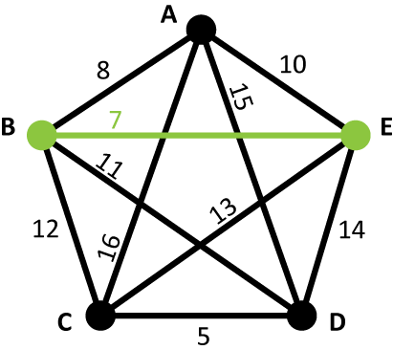
Nearest-Neighbor Algorithm
Choose the cheapest edge
In this case, we go from B to E (7)

Slide 7
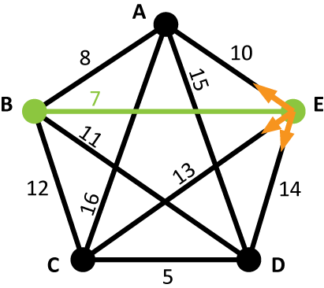
Nearest-Neighbor Algorithm
Now where do we go?
We can’t go back to B

Slide 8
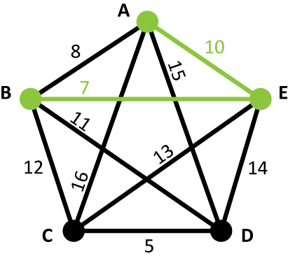
Nearest-Neighbor Algorithm
Now where do we go?
We can’t go back to B
Again choose the cheapest edge

Slide 9
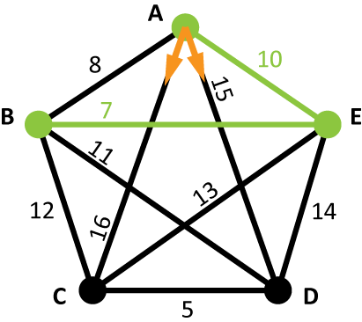
Nearest-Neighbor Algorithm
Now where do we go?
We can’t go back to E, but we also can’t go to B

Slide 10
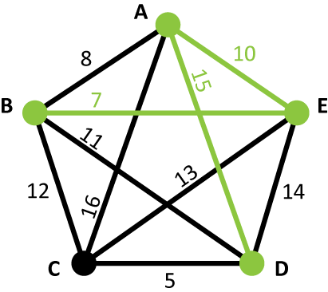
Nearest-Neighbor Algorithm
The rule is “nearest neighbor”: always choose the lowest cost edge, unless that would take you back to a vertex you have already been to

Slide 11
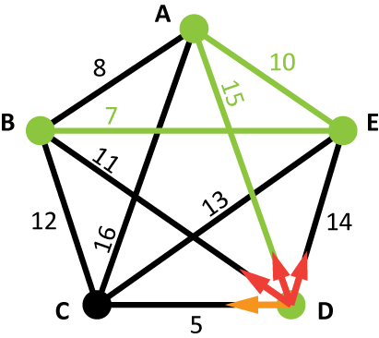
Nearest-Neighbor Algorithm
Now we only have one choice
We can’t go back to A or E, and we can’t return to B because that would leave out C

Slide 12
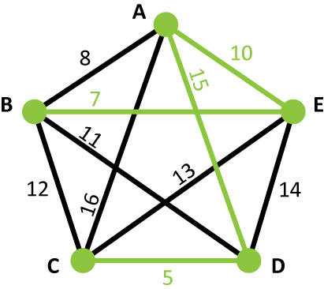
Nearest-Neighbor Algorithm
Now we only have one choice
We can’t go back to A or E, and we can’t return to B because that would leave out C
So we must go to C

Slide 13
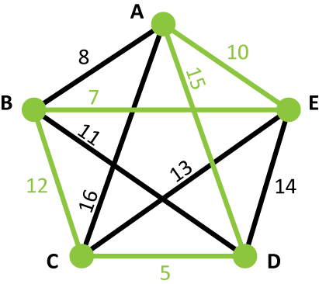
Nearest-Neighbor Algorithm
We have now visited all of the vertices, so we finally return to B
This circuit has a total cost of 49
Is it the best circuit?

Slide 14
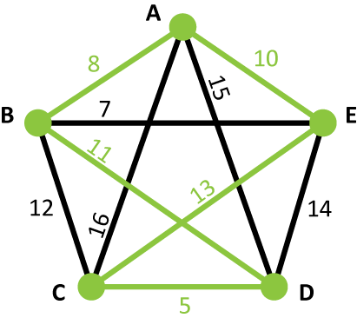
Nearest-Neighbor Algorithm
It is not the best! The solution on the left has a total cost of 47

Slide 15
Nearest-Neighbor Algorithm
From the starting vertex, choose the edge with the smallest cost and use that as the first edge in your circuit.
Continue in this manner, choosing among the edges that connect from the current vertex to vertices you have not yet visited.
When you have visited every vertex, return to the starting vertex.

Slide 16
Nearest-Neighbor Algorithm
Advantages: easy, “heuristic,” and fast
Disadvantage: doesn’t always give you the best possible answer
“Heuristic” means that this method uses a common-sense idea

Slide 17
Sorted-Edges Algorithm
Now let’s consider another algorithm for finding Hamiltonian circuits: the sorted-edges algorithm
This one is also based on a heuristic: use cheap edges before expensive ones

Slide 18
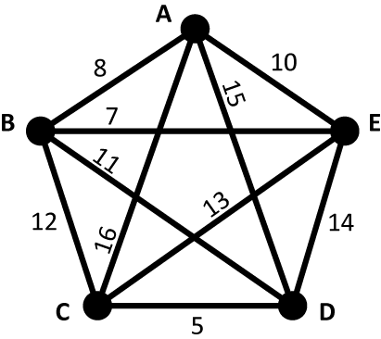
Sorted-Edges Algorithm
We want to use the cheapest edges we can
So let’s make a list of all the edges, from least expensive to most expensive

Slide 19
Sorted-Edges Algorithm
C-D (5)
B-E (7)
A-B (8)
A-E (10)
B-D (11)
B-C (12)
C-E (13)
D-E (14)
A-D (15)
A-C (16)

Slide 20
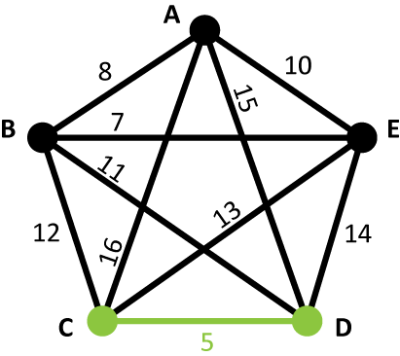
Sorted-Edges Algorithm
The cheapest edge is C-D (5)
We’ll add it to the circuit we’re building

Slide 21
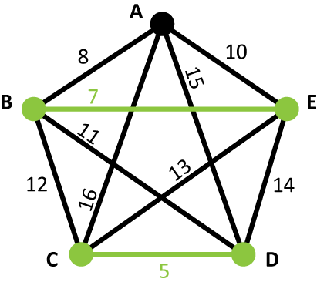
Sorted-Edges Algorithm
The next-cheapest edge is B-E (7)
We’ll also add this to our circuit
Note that the edges don’t connect to each other (yet)

Slide 22
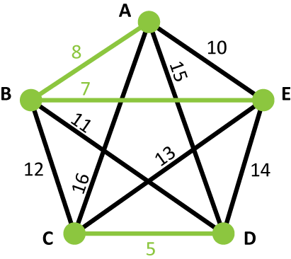
Sorted-Edges Algorithm
Next is A-B (8)
So far we just add the cheapest edges to our circuit
But we’re about to encounter a problem

Slide 23
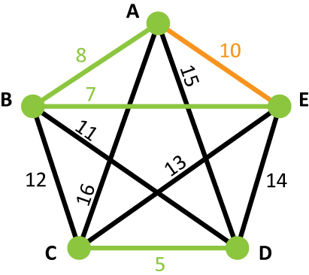
Sorted-Edges Algorithm
The next cheapest edge is A-E (10)
However, if we include that edge, this creates a circuit that leaves out C and D
That won’t be Hamiltonian!

Slide 24
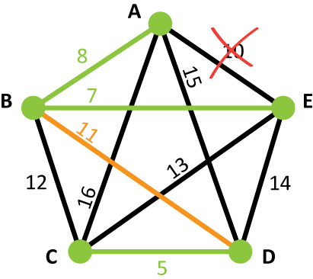
Sorted-Edges Algorithm
So we skip over that edge and look for the next cheapest edge, which is B-D (11)
If we include this edge, then we’ll have three edges that all meet at B
We can’t have that in a Hamiltonian circuit

Slide 25
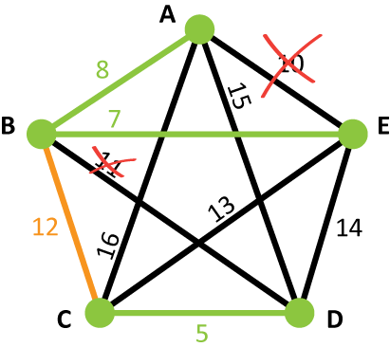
Sorted-Edges Algorithm
So again we skip that edge and look for the next cheapest edge, which is B-C (12)
But again we can’t use this edge since this would give us three edges meeting at the same vertex

Slide 26
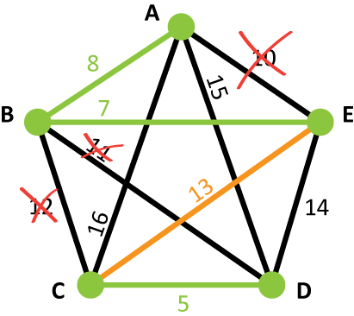
Sorted-Edges Algorithm
Moving on, the next edge is C-E (13)
We have no problems using this edge, so it goes into our circuit

Slide 27
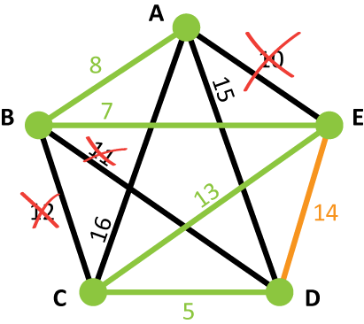
Sorted-Edges Algorithm
The next edge is D-E (14)
This edge creates a circuit that doesn’t include all the vertices
Also, it creates three edges meeting at E!

Slide 28
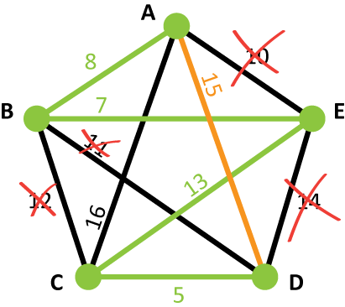
Sorted-Edges Algorithm
The next edge is A-D (15)
This edge creates a circuit, but it includes all the vertices
This is the last edge we need to complete our Hamiltonian circuit

Slide 29
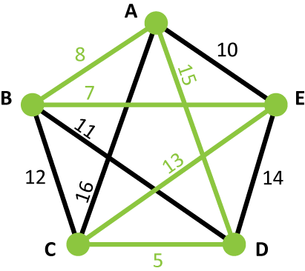
Sorted-Edges Algorithm
Our plan was to use the cheapest possible edges, but because our final goal was a Hamiltonian circuit, we had to leave some of the cheap edges out and use some of the more expensive ones

Slide 30
Sorted-Edges Algorithm
As a result, we didn’t end up with the best possible answer!

Slide 31
Sorted-Edges Algorithm
Sort the edges from lowest cost to highest cost
Add edges to your circuit, one at a time, in order of increasing cost
Skip over edges that would cause you to have three edges at a single vertex or create a circuit that does not include all vertices
Keep going until you have a Hamiltonian circuit

Slide 32
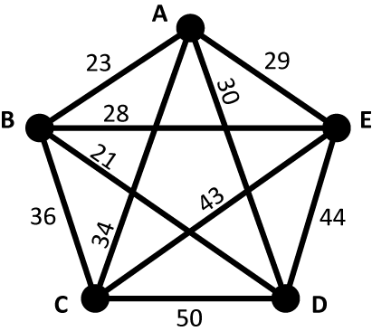
Your Turn: Nearest-Neighbor
From the starting vertex, choose the edge with the smallest cost and use that as the first edge in your circuit.
Continue in this manner, choosing among the edges that connect from the current vertex to vertices you have not yet visited.
When you have visited every vertex, return to the starting vertex.
For this example, start at C

Slide 33
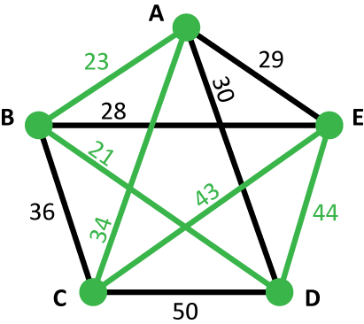
Your Turn: Nearest-Neighbor
The solution is shown here
This circuit has a total cost of 165
If we had chosen a different starting point, we may have produced a different solution

Slide 34
Your Turn: Sorted-Edges
Sort the edges from lowest cost to highest cost.
Add edges to your circuit, one at a time, in order of increasing cost.
Skip over edges that would cause you to have three edges at a single vertex or create a circuit that does not include all vertices.
Keep going until you have a Hamiltonian circuit.

Slide 35
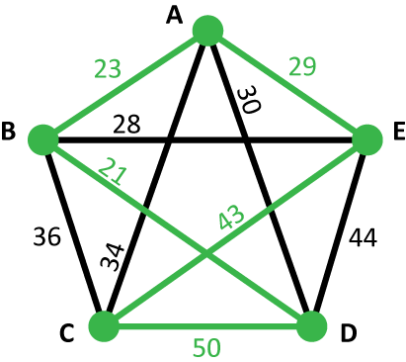
Your Turn: Sorted-Edges
The solution is shown here
This circuit has a total cost of 166
Did either method produce the best possible circuit? The only way to know for sure would be to use the brute-force method

